Slide 1
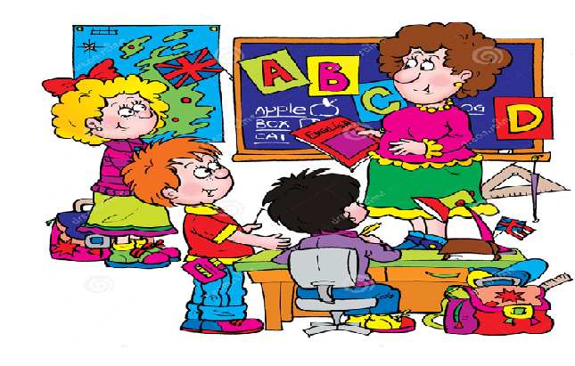
Welcome to our English class!

Slide 2
1. What …….. you want to be when you ……….. up?
QUESTIONS
do
grow
I ……… to be an actor.
want
2. What …….. he want to be when he ……….. up?
does
grows
………. she
does
she ……….
grows up
He ……… to be an actor.
wants
/z/
She
wants

Slide 3
PRACTICE
What does he/she want to be when he/she grows up?
=> He/She wants to be a/an…………..

Slide 4
PRACTICE
What ……. he/she want to be when he/she ….. up?
=> He/She ………. to be a/an…………..

Slide 5
What do you want to be when you grow up?
What do you want to be when you are older?
I want to be a pilot.
I want to fly a helicopter.
What ……… you want ……….. when you …… older?
do
to do
‘re
‘re = are

Slide 6

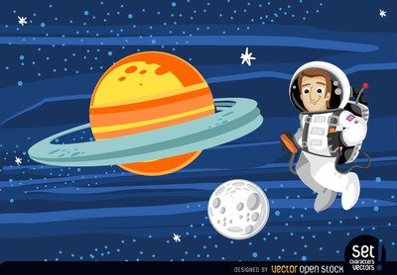
VOCABULARY
an astronaut
space
space
He wants to go to space.

Slide 7
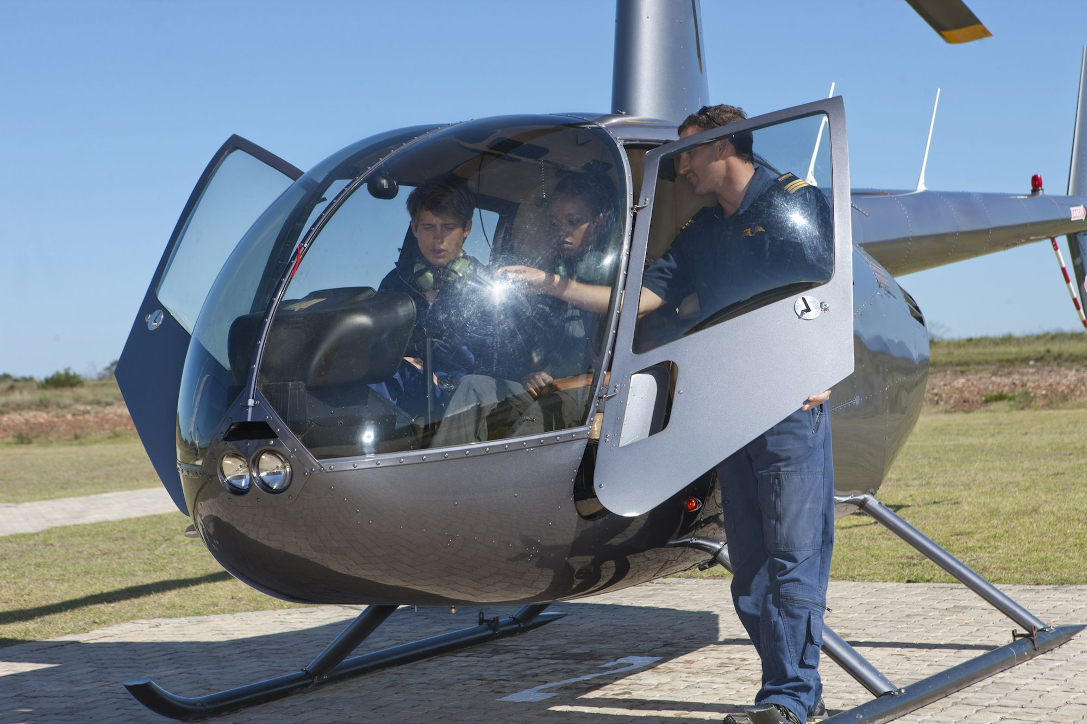
a helicopter
a pilot
They want to fly a helicopter.

Slide 8
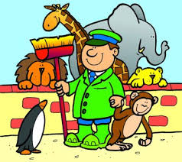
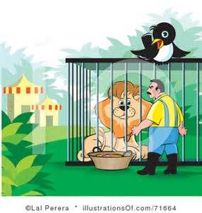
a zoo keeper
They want to work with animals.

Slide 9
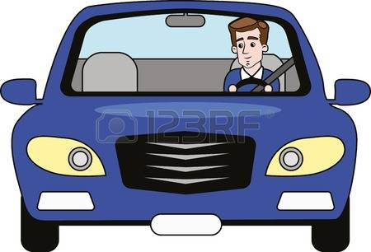

a car
a race car
He wants to drive a car.
He wants to drive a race car.

Slide 10
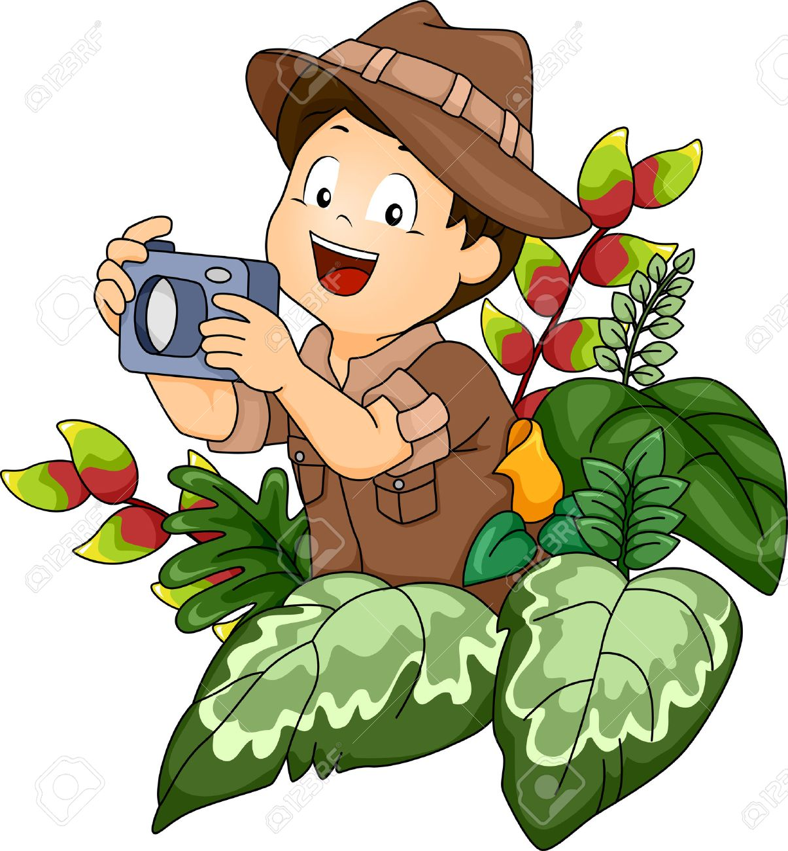
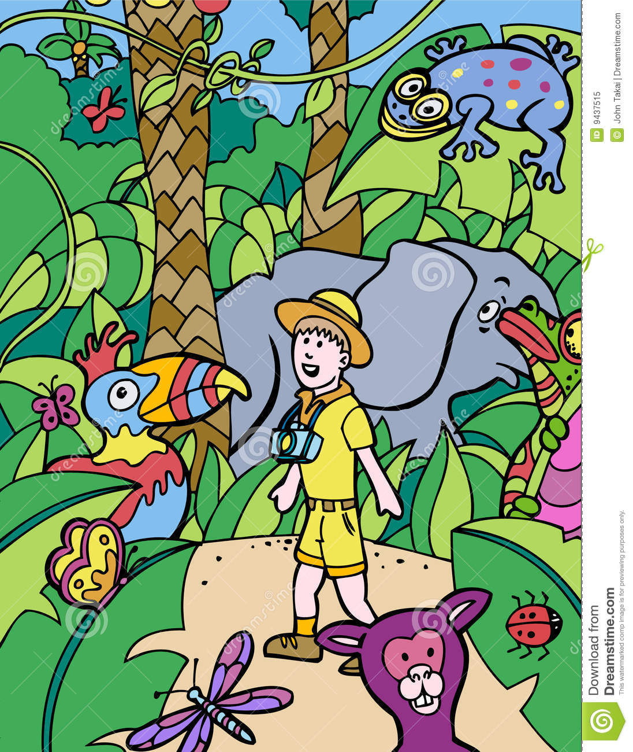
They want to explore the jungle.

Slide 11

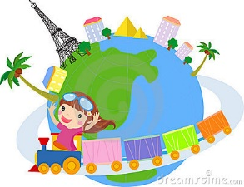
They want to travel the world.

Slide 12
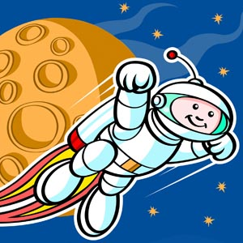
QUESTIONS
What ……... you want ……….. when you ……… older?
do
to do
‘re
I want to go to space.
‘re = are
PRACTICE
Open your student book to page 60!

Slide 13
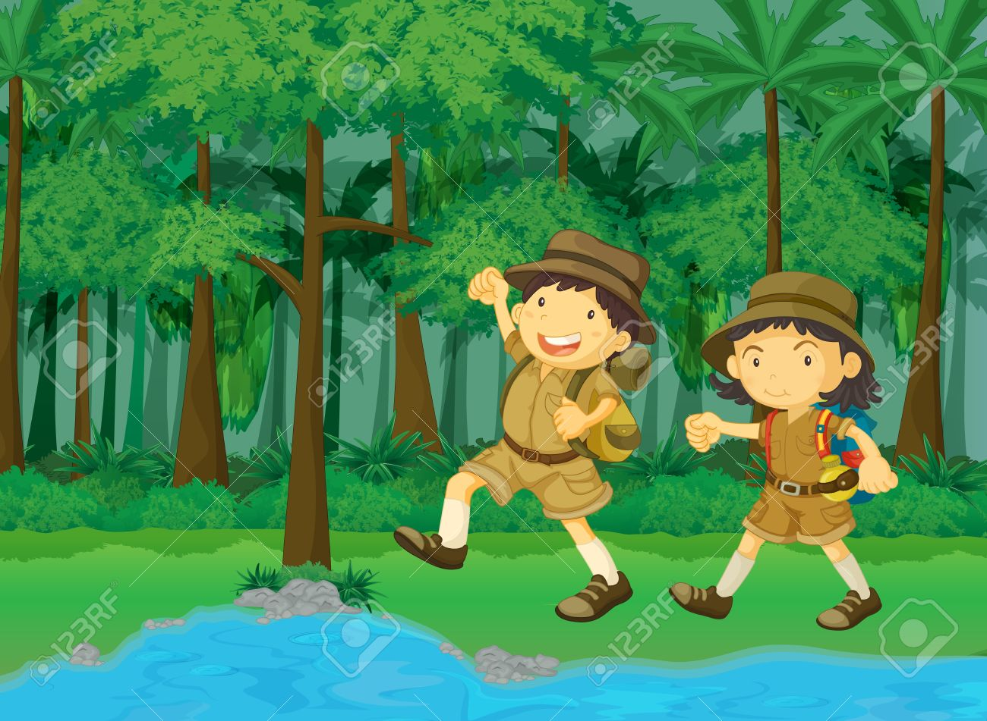
QUESTIONS
What ……... he want ……….. when he …… older?
does
to do
‘s
she ……
………. she
‘s
does
He wants to explore the jungle.
She wants to explore the jungle.
PRACTICE
Open your student book to page 61!

